Slide 1
What are the Effects of Aspartame on the Brain/Body?
Shea Lindsay and Sterling Petersen

Slide 2
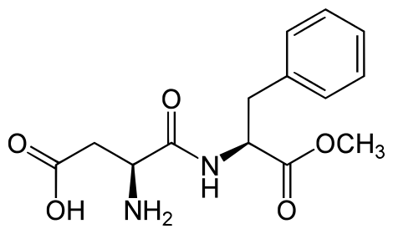
Aspartame
Structure and Function
Aspartame AKA l-aspartyl-l-phenylalanine methyl ester
Aspartame is a methyl ester of the aspartic acid/phenylalanine dipeptide
Upon ingestion approximately 50% of the aspartame molecule is phenylalanine, 40% is aspartic acid and 10% is methanol

Slide 3
Where is it found?
In 1965 aspartame was discovered by James Schlatter and was approved for use by the FDA in the 1970s.
Schlatter synthesized aspartame while attemping to generate tetrapeptides of gastrin for the use of assessing anti-ulcer drug candidates
He licked his fingers while turning a page and tasted something sweet

Slide 4

Public Exposure to the Toxin
Aspartame exposure is mainly through ingestion of processed foods and drinks
The main source of exposure in the U.S. is in soft drinks/soda
It can also be found in gum and pharmaceutical preparations

Slide 5

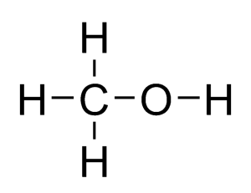
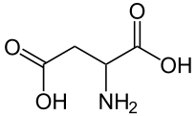
Mechanism of Toxin
Aspartame has a very rapid breakdown in the GI tract into
  Phenylalanine
  Methanol
  Aspartic Acid

Slide 6
Phenylalanine
Amino acid found in protein or aspartame. Research shows consuming a protein rich diet along with aspartame had even higher increases in plasma/brain phenylalanine.
The increase levels in the brain inhibit the synthesis of neurotransmitters such as serotonin and catecholamines
These decreases in NT’s may cause headaches, seizures, insomnia, and other behavioral disturbances

Slide 7
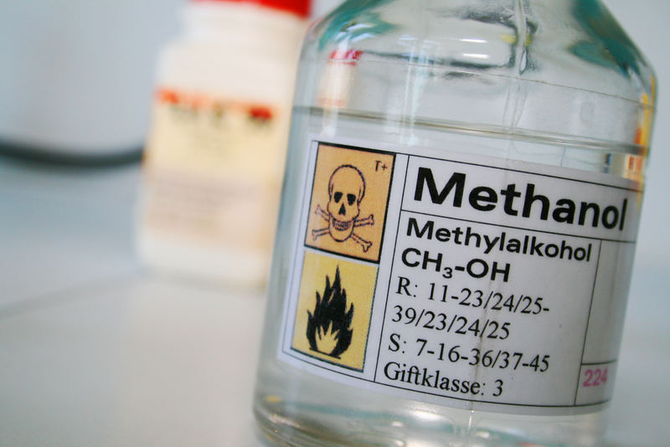
Methanol
Methanol is naturally released from fruits and vegetables. It is also produced in the body.
Main cause of large doses of exposure are from home distilled spirits
Methanol is metabolized to formaldehyde and then to formate in the body. Accumulation of formate makes the body more susceptible to methanol toxicity. With the formation of formate, also creates superoxide and hydroxyl radicals commonly known as free radicals.
It is then broken down into carbon dioxide and water to be eliminated through urine.

Slide 8
Aspartic Acid
Amino acid that is converted into glutamate in the body. It is a non-essential amino acid because it can be synthesized in the liver from other amino acids.
Glutamate is a neurotransmitter found in the CNS, but high levels can cause excitotoxicity.
Excitotoxicity is the ability of glutamate to destroy neurons by prolonged excitatory synaptic transmission.
It is eliminated the same way as all amino acids as the breakdown from NH3 to NH2 and is eliminated as urea in humans.

Slide 9
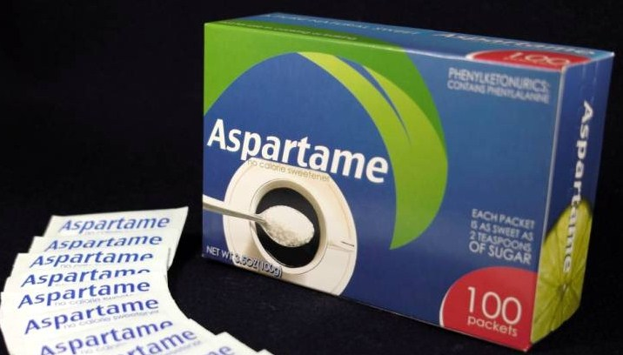
Human Exposure
Human exposure to Aspartame is through ingestion of foods and beverages containing the toxin
1 in 5 Americans consume at least 1 soda/soft drink containing aspartame per day
Each person chews an average of 280 sticks of chewing gum per year

Slide 10

Safer Alternative?
We all know sugar is not the healthiest substance to consume but….
Natural raw sugar is a safer option for sweetener
The best option is NONE!!

Slide 11
Resources
Maher, T. J., & Wurtman, R. J. (1987). Possible neurologic effects of aspartame, a widely used food additive. Environmental Health Perspectives, 75, 53–57.
Ashok, I., & Sheeladevi, R. (2014). Biochemical responses and mitochondrial mediated activation of apoptosis on long-term effect of aspartame in rat brain. Redox Biology, 2, 820–831. doi:10.1016/j.redox.2014.04.011
Magnuson, B. (2011). Relationship Between Aspartame, Methanol and Formaldehyde Explained. Evidence Analysis Library. (NNNS) (2010-2011).
Purves D, Augustine GJ, Fitzpatrick D, et al., editors. Neuroscience. 2nd edition. Sunderland (MA): Sinauer Associates; 2001. Glutamate. Available from: http://www.ncbi.nlm.nih.gov/books/NBK10807/

